Slide 1
Accelerator Reliability Workshop October 16-21, 2022 Thomas Jefferson National Accelerator Facility Newport News, Virginia USA
2
Photo by Brian Lockwood

Slide 2
Jefferson Lab
Jefferson Lab is a nuclear physics laboratory in Newport News, Virginia in operation since 1995
The Continuous Beam Electron Acceleratory Facility (CEBAF) was originally a 6GeV machine, upgraded to 12 GeV
By April 2020, well into the 12 GeV Era
Jefferson Lab hosts major conferences
Experienced conference management and event planning team with a robust history of meeting the needs of participants
IPAC 2015 in Richmond, VA--with 1200 participants
Joint HSF/OSG/WLCG Workshop (HOW 2019) in Newport News, VA--with 280 participants, 2 receptions, multiple parallel session and intricate A/V requirements
Notes:
-Is this information current

Slide 3
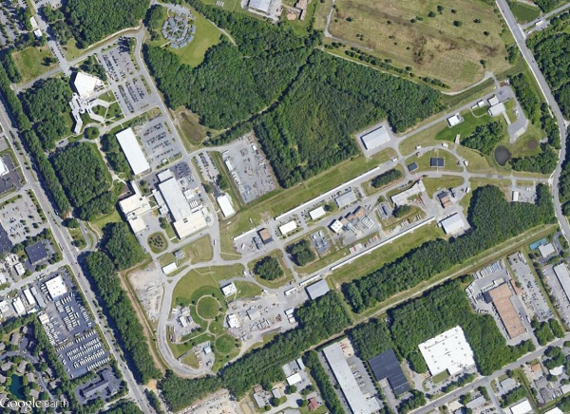
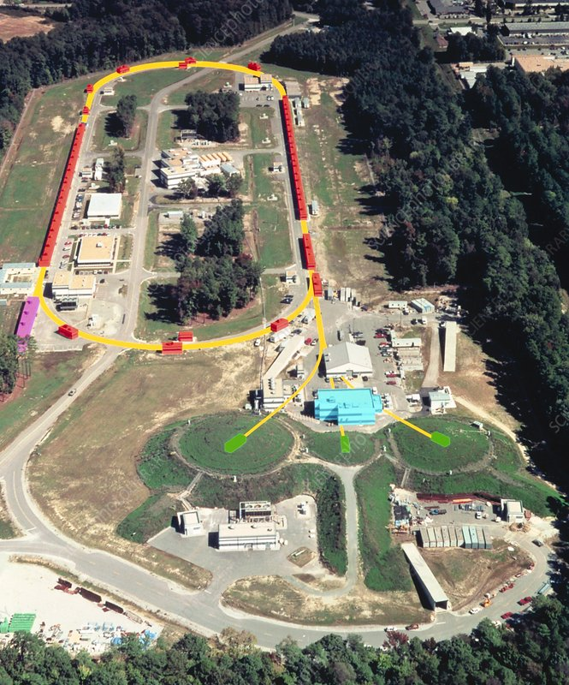
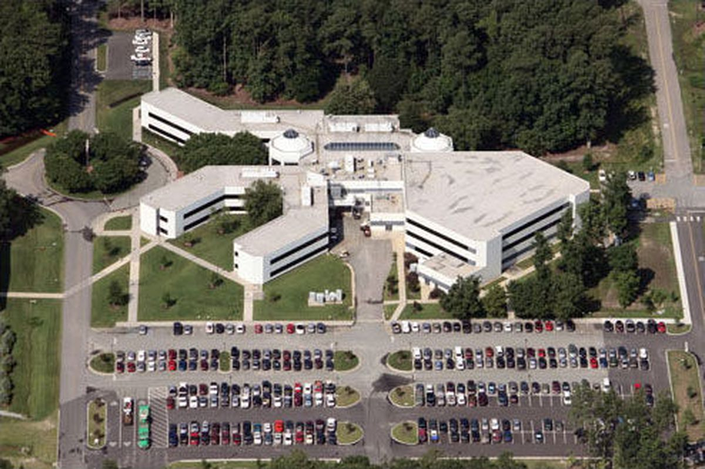
Bird’s-Eye View CEBAF and JLAB Campus

Slide 4
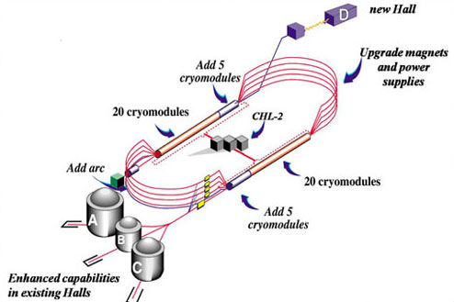
Project Overview
The 12GeV Upgrade doubled the energy of the CEBAF accelerator, added a new experimental hall and enhanced capabilities of existing experimental halls

Slide 5
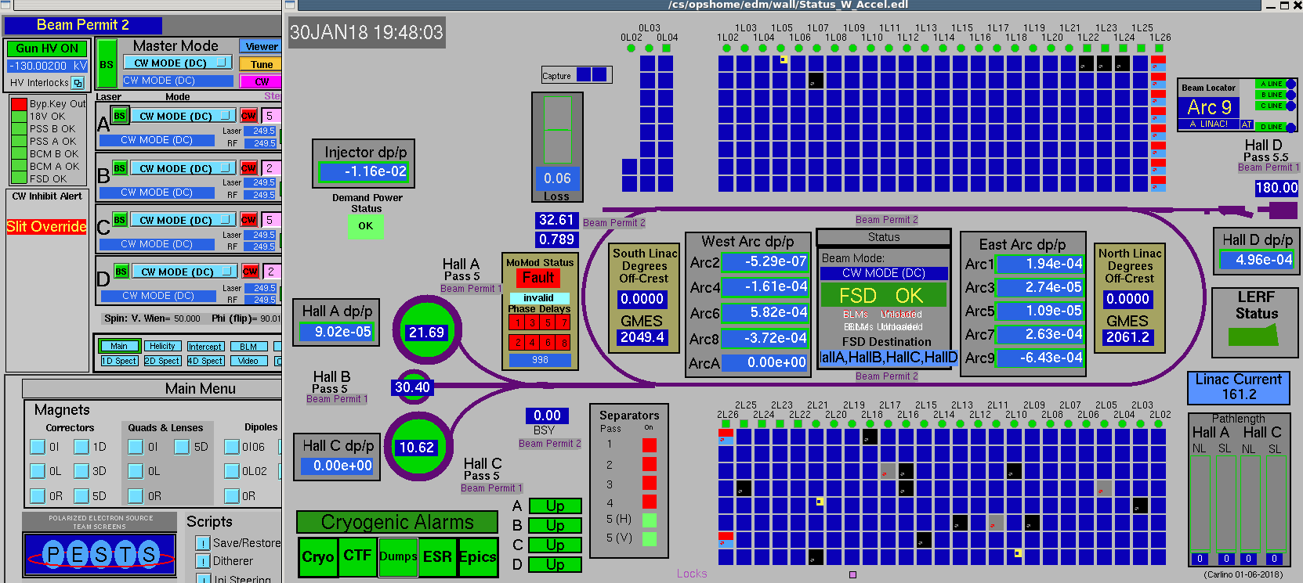
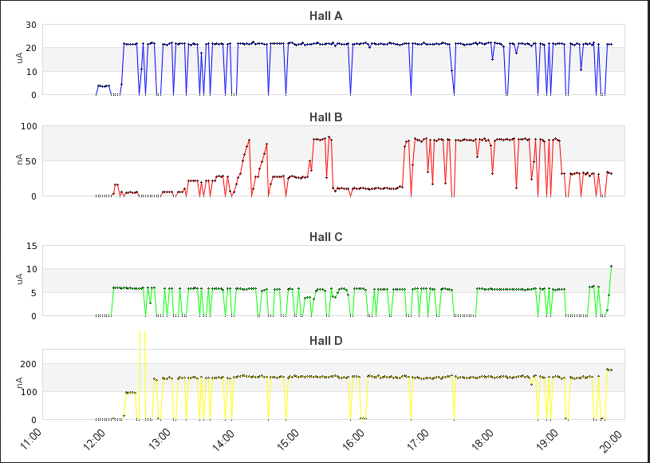
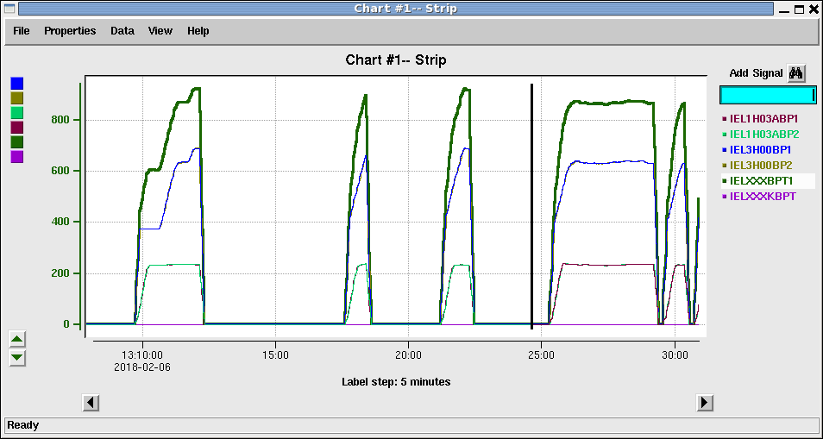
Progress
First 4 Hall Operations
1/30/2018
CEBAF Achieves Full Power
2/6/2018

Slide 6
Virtual or Visit?
We believe it is important to work to get people together again face-to-face
The current planning is to have an onsite workshop!
Pandemic protocols may affect the plans but we have cleared many hurdles already
Changes will be communicated via email and through the website
We have great event planning support who are working to make this event successful!
ARW email has been setup for announcements
Please email baggett@jlab.org to get added to the email list
ARW Website under development
URL - https://www.jlab.org/conference/ARW

Slide 7
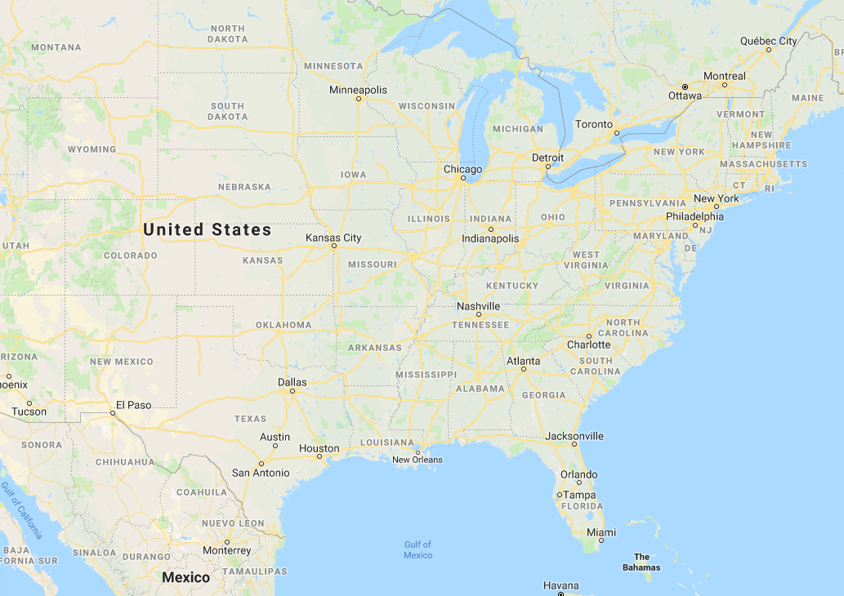
Location of Jefferson Lab

Slide 8
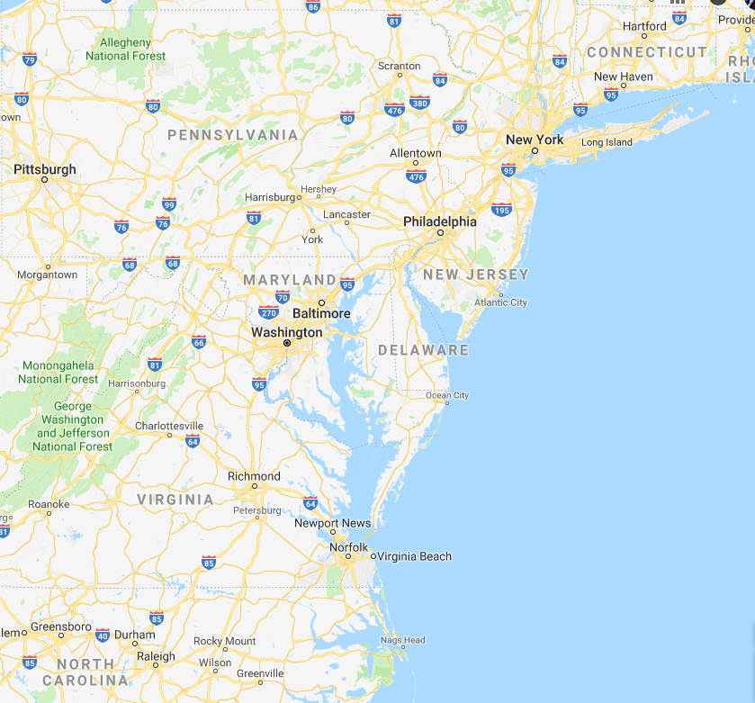
Location of Newport News, Virginia
3.5 hrs
3 hrs
2 hrs

Slide 9
Hotel Room and Travel
Hotel rooms available in the heart of Newport News’ business, shopping and entertainment district.
The Newport News Marriott at City Center & The Holiday Inn Newport News/Hampton
Lodging currently available at the prevailing US Per Diem rate
Currently ~$96US/night (~87 euro)
Getting to Newport News
Major airlines serve the Newport News/Williamsburg International Airport (PHF) and Norfolk International Airport (ORF)
For tickets booked reasonably in advance:
US/Canada: < $500US
From Europe: < $1500US
From Asia: <$1500US
Other Options include:
Washington Dulles International Airport
Three hours by car and many tourism options along the way
Possible to get to Newport News from DC by train for ~$80US
Scenic although somewhat complicated and slow

Slide 10
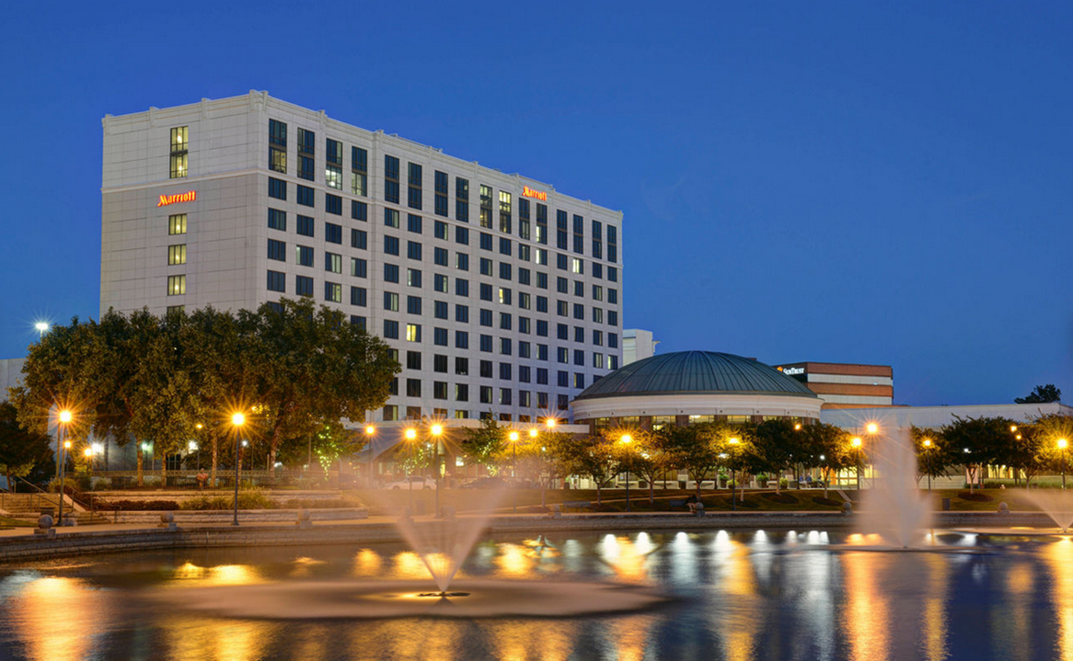
Newport News Marriott at City Center
This full-service Marriott overlooks the impressive City Center fountain and provides an ideal setting for business or leisure travel. Enjoy the many dining and entertainment options in the pedestrian friendly City Center.

Slide 11
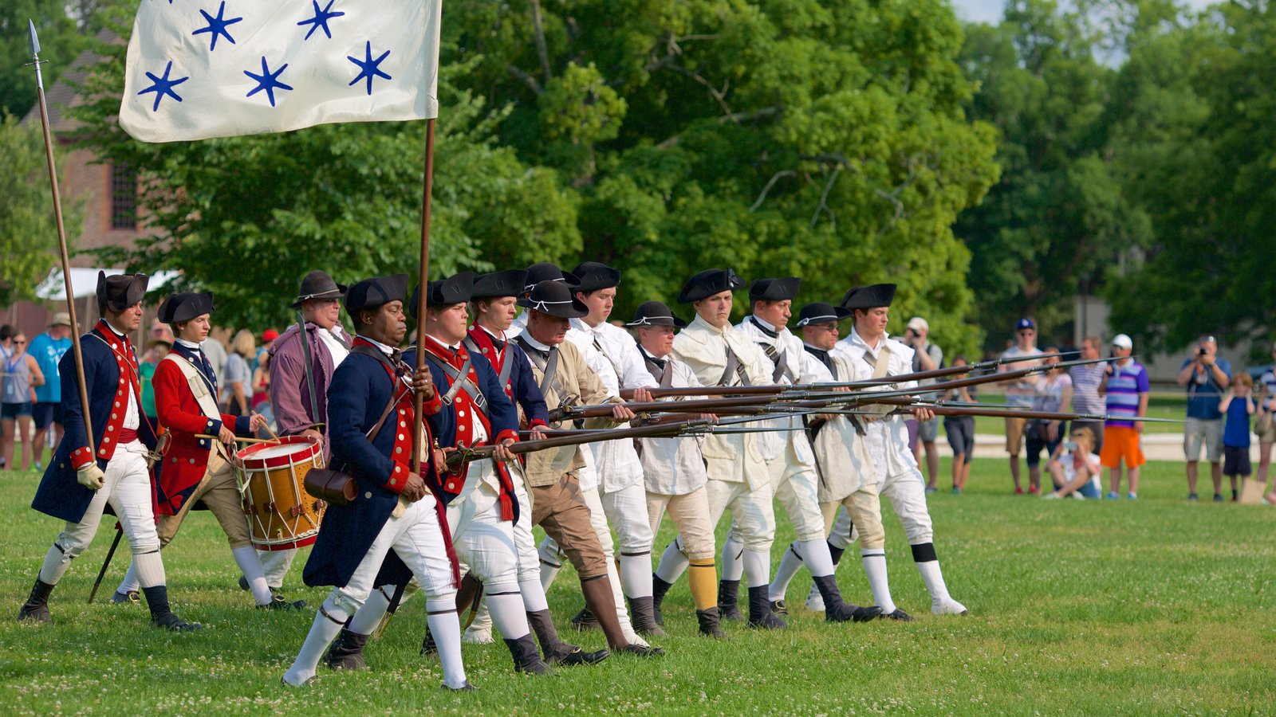
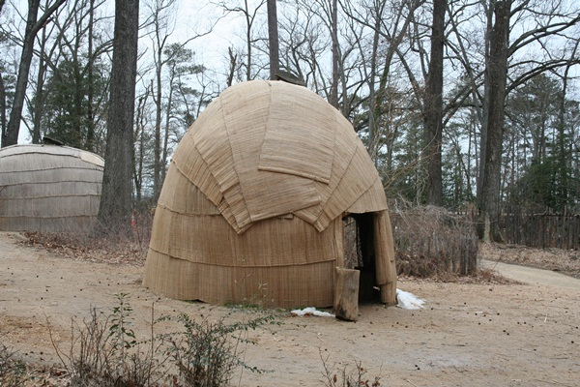
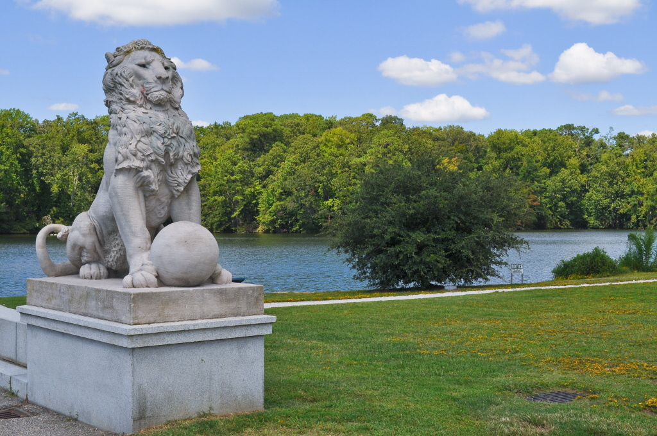
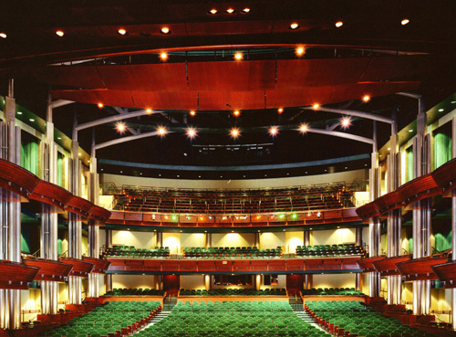
Tidewater Area Attractions/Excursions

Slide 12
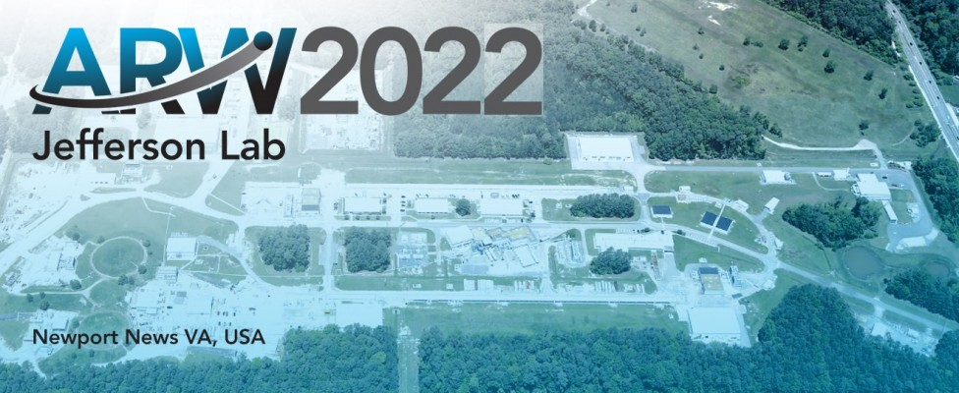
Thank You!
https://www.jlab.org/conference/ARW
Photo by Brian Lockwood

